Slide 1
WEB OF SCIENCE – RESEARCH & DISCOVERY PLATFORM

Slide 2
AGENDA:
WEB OF SCINCE – Discovery Starts Here
WEB OF SCIENCE CORE COLLECTION:
Introduction:- Research & Discovery Platform
Content and Coverage→ LIVE DEMO
Core Functionalities → LIVE DEMO
Foundational Values
Q&A

Slide 3
SSR PORTFOLIO OVER RESEARCH CIRCLE
Research Thought
Web of Science Platform with:
Web of Science Core Collection
BIOSIS
Biological Abstracts
Chinese Science Citation Database
Zoological Records
Derwent Innovation Index
Other Hosted Content
ResearcherID
Promote
Literature search
InCites
ESI
Evaluate
Research Circle
Research
Publish
Discover
ScholarOne
Review
Write
Submit
EndNote
EndNote Web
JCR

Slide 4
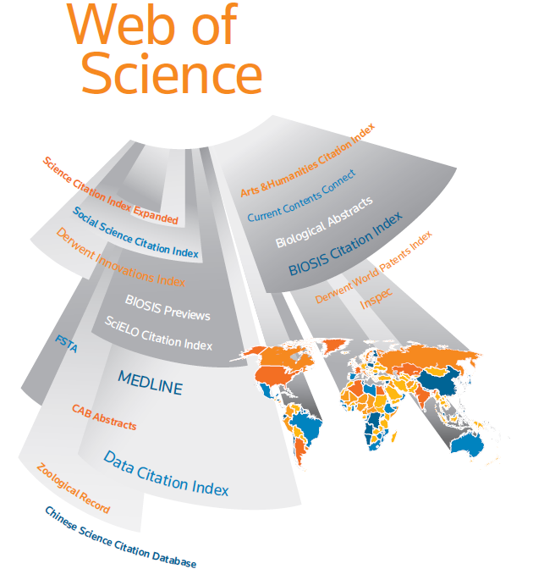
THOMSON REUTERS SSR PORTFOLIO

Slide 5
WEB OF SCIENCE → RESEARCH & DISCOVER PLATFORM
A comprehensive, intelligent information gathering resource.
Researchers can use citations to navigate forward, backward and through over 12,000 most prestigious, high impact journals in the world; searching all disciplines to uncover all the relevant information to their research.

Slide 6
CONTENT AND COVERAGE
Science Citation Index Expanded (SCIE)
from 1899: more than 8,000 journals
Social Sciences Citation Index (SSCI)
from 1898; about 3,000 journals
Arts and Humanities Citation Index (AHCI)
from 1975; about 1,200 journals
Conference Proceedings (CPCI)
from 1990; over 12,000 conferences per year
Book Citation Index (BkCI)
from 2005; over 25,000 books
Current Chemical Reactions (CCR-EXPANDED)
1985-present
Index Chemicus (IC) --1993-present

Slide 7
CORE FUNCTIONALITIES
Various Searching Capabilities
Refine & Analyze Results
Endnote web & Researcher ID
Citation Maps
WoS Record & Related Records
Citation Report

Slide 8
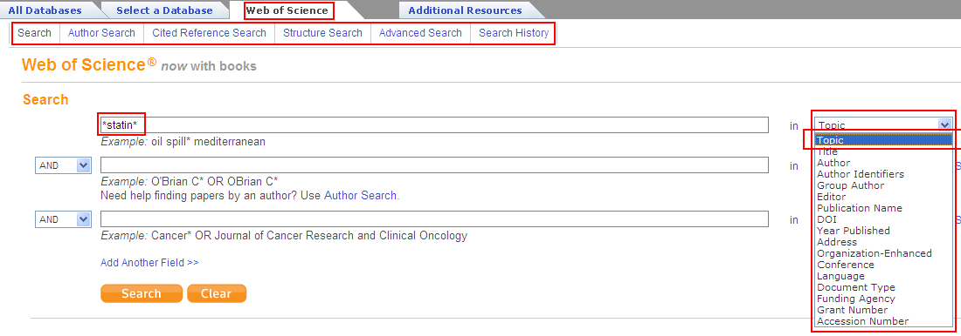
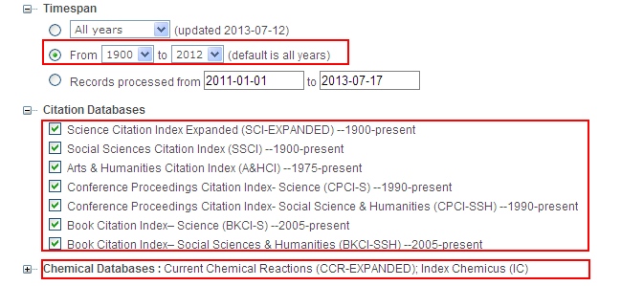
Various Searching Capabilities

Slide 9
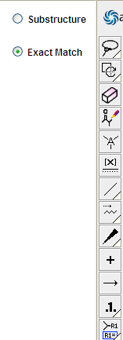
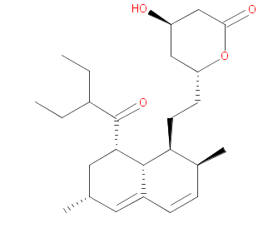
Structure Search

Slide 10
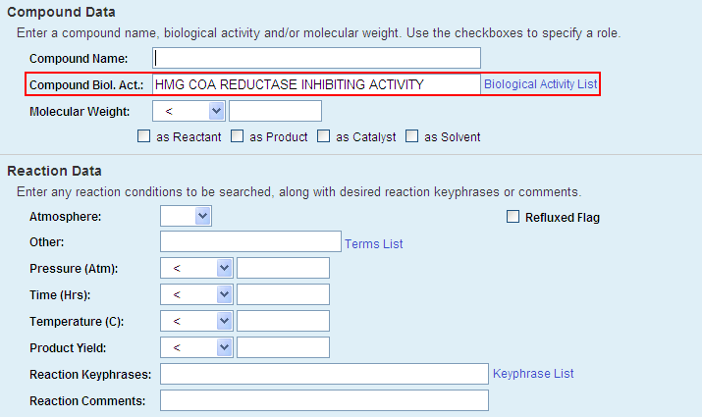
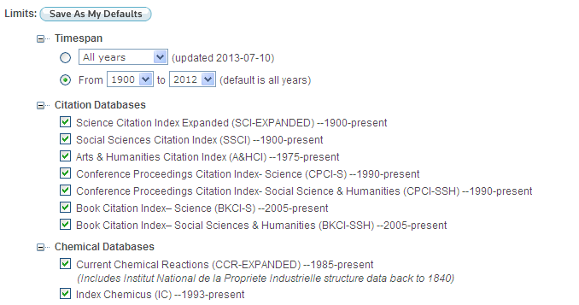
Structure Search

Slide 11
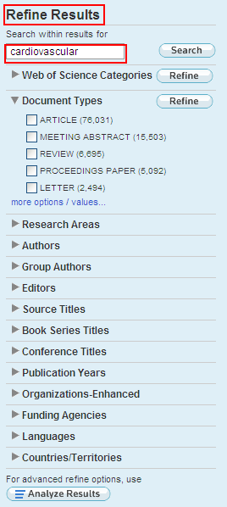
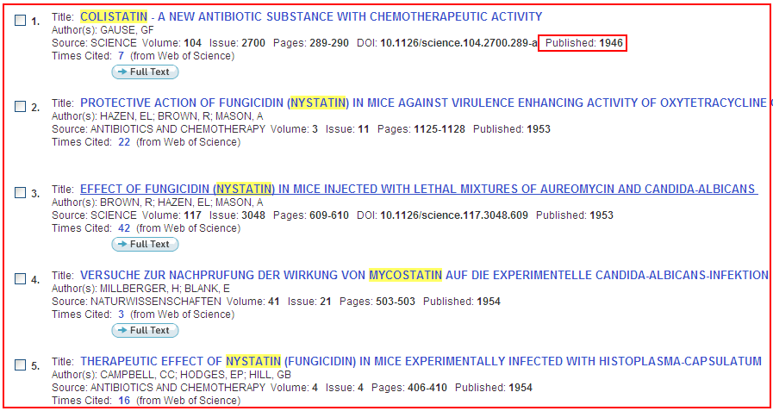
Search Results

Slide 12
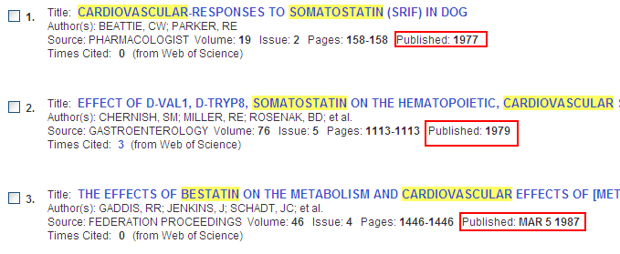
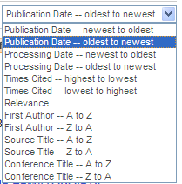
Refine Results
Search with-in the search or refine by many other options, like Subject Areas etc.. to refine your results.
Eg: Here I searched for word “cardiovascular” to get the results narrowed down to “8853”

Slide 13
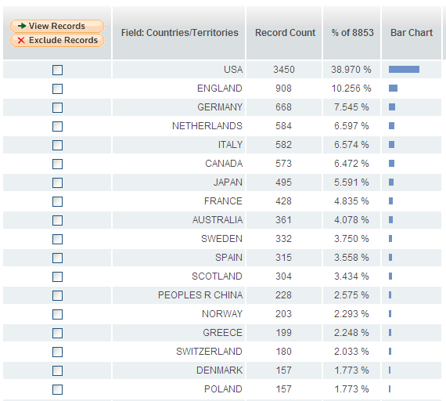
Analyze Results

Slide 14
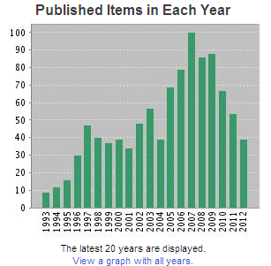
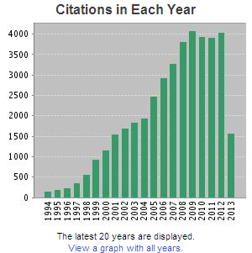
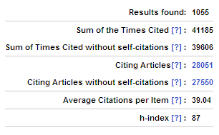
Citation Report

Slide 15
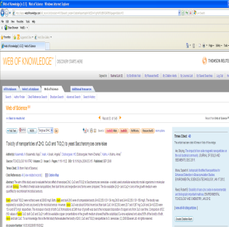
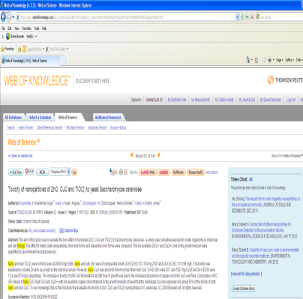
Related Records
2010
Times Cited
2008
2008
1993
2011
2012
Cited References
Related Records
2000
2000
1998
1974
2008
2009
1974
2008
Web of Science Unique info

Slide 16
Citation Maps

Slide 17
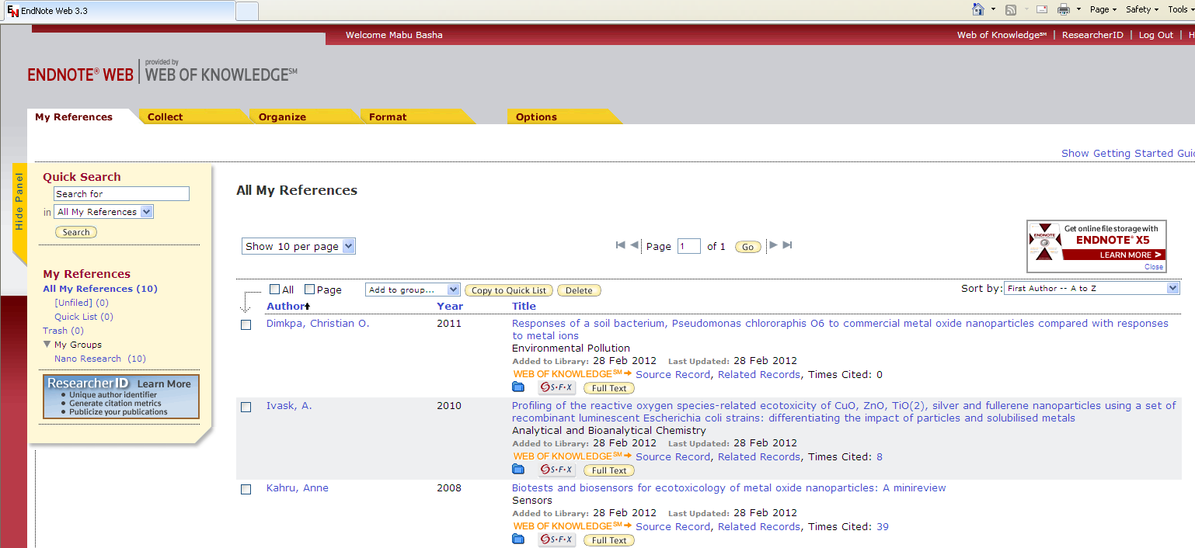
Endnote Web
Web-based reference organizer and collaboration tool that enables users to collect references and collaborate easily with others.
Cite While You Write

Slide 18
FOUNDATION VALUES
Relevance → The most influential/highly cited scholarly content. Uncover hidden relationships between seemingly unrelated content.
Precision → Integrated navigation. Refine & Analyze
Depth & Diversity → Back Files of 100 yrs research data covering 230 disciplines.
Objectivity & Quality → Selective, unbiased, peer review, global and regional representation
Authentic → Creators of the Impact Factor, Cite While You Write and more.
Collaboration → Integration that promotes discovery and publishing
Notes:
Relevance; The most influential/highly cited scholarly content. Significant and useful. Designed to conserve institutions resources and researchers time. Impact a crucial measure of excellence and quality is objective, quantitative and comparable. Uncover hidden relationships between seemingly unrelated content. Implement highly applicable and unique content and peer review workflow systems.
Precision; Integrated navigation. Analyze and refine. Retrieve as much or as little as desired. Controlled vocabulary and indexing. Accurate and without redundancies. Identify, unify, standardise. Locate peer reviews and check references with exactness. Access to original data.
Depth; Comprehensive. 100 years of research enable researchers to dig deep. Access to ground breaking and influential works. Multidisciplinary content allows researchers to dig wide with over 230 disciplines covered. A team with decades of experience. Drill down to the deepest level of data.
Objectivity; Selective, unbiased, time tested consistently applied selection criteria. Impact influence timeliness, peer review, global and regional representation are the standards of measure. Continuous monitoring to ensure high standards are maintained.
Authentic; In 1955 Dr Garfield revolutionised scientific research with his ground breaking paper on citation indexing and searching. Reliable. Trusted. Innovative. Creators of the Impact Factor, Cite While You Write and more.
Collaboration; Develop implement, feedback, refine. Responsive. Customer consultations drive individualised agile workflow systems. Integration that promotes discovery and publishing.

Slide 19
REGIONAL DIVERSITY IN JOURNALS
Region | Journals | %
Europe | 5573 | 49%
North America | 4251 | 38%
Asia Pac | 965 | 9%
Latin America | 272 | 2%
Middle East/Africa | 200 | 1%
Language | Journals | %
English | 9114 | 81%
Non-English | 2147 | 19%
Country | Journals
India | 150
Bradford’s Law - A relatively small number of journals accounts for most of the important scientific information in the world.
Recent research has shown that 2000 journals account 95% of cited articles.
We have the BEST (12,000+ Journals) not the REST
Notes:
Figures for Editorial Link pages Summer 2010
https://thelink.thomsonreuters.com/portal/server.pt/community/global_editorial_operations/4698/literature_production/312448
Remember there are approx. 50,000 journals. Instead of trying to cover all the journals we look to cover the ‘most influential’.
Scopus - a competitor to WoS has lots more journals, WoS only has the best, not the rest.
Samuel Bradford http://en.wikipedia.org/wiki/Bradford%27s_law
http://revistes.iec.cat/index.php/IM/article/viewFile/4c457c8c230e1.002/9558

Slide 20
WEB OF SCIENCE
Thank You All !!!!

